Slide 1
UNIT–V
Agile Methods with RUP and PRINCE2 and Tools and Obstacles

Slide 2
Agile modelling and RUP
FDD and RUP
Agile methods and prince2
Tools to help with agile development
Eclipse: An agile IDE
Obstacles to agile software development
Management intransigence
The failed project syndrome
Contractual difficulties
Familiarity with agility

Slide 3
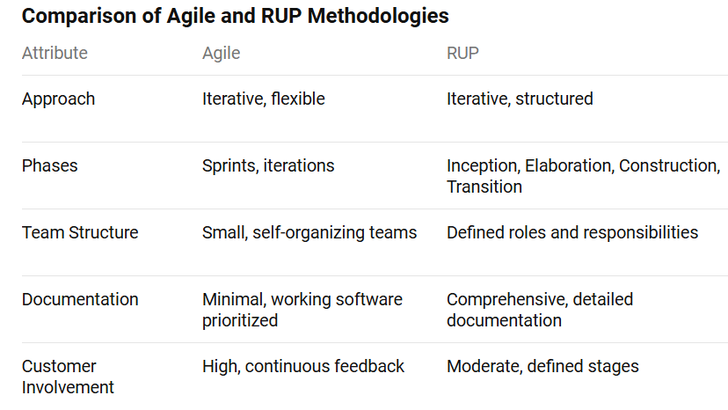
Agile and RUP (Rational Unified Process) are distinct software development methodologies with unique characteristics and approaches

Slide 4
Agile is best for projects needing rapid adaptation and continuous feedback, while RUP suits projects requiring a structured approach with detailed documentation and predefined phases.
Both methodologies have their strengths and can be chosen based on the specific needs and goals of the project.

Slide 5
Agile modelling and RUP
The Rational Unified Process is a framework for handling the whole lifecycle of a software development project.
It is called a process because its primary aim is to define:
Who is doing what?
When they do it?
How to reach a certain goal (i.e. each activity)?
The inputs and outputs of each activity.

Slide 6
There are four key elements to the philosophy behind the Unified Process. These four elements are:
Iterative and incremental
Use-case driven
Architecture-centric
Acknowledges risk

Slide 7
Iterative and incremental
Essentially, the following holds with the iterative approach in the Unified Process:
You plan a little.
You specify, design and implement a little.
You integrate, test and run.
You obtain feedback before the next iteration.

Slide 8
Lifecycle Phases of RUP
The four phases and their roles are outlined below.
Inception.
This phase defines the scope of the project and develops the business case for the system.
It also establishes the feasibility of the system to be built. Various prototypes may be developed during this phase to ensure the feasibility of the proposal
Elaboration.
This phase captures the functional requirements of the system.
The other primary task for this phase is the creation of the architecture to be used throughout the remainder of the Unified Process.

Slide 9
Construction. This phase concentrates on completing the analysis of the system, performing the majority of the design and the implementation of the system. That is, it essentially builds the product.
Transition. The transition phase moves the system into the users environment. This involves activities such as deploying the system and maintaining it.

Slide 10
FDD and RUP
Agile Modelling is not the only agile methodology that can be usefully applied to a software project that is employing the Unified Process.
Feature-Driven Development is another method with things to offer an RUP project
One area in which we have found it beneficial to amend the Unified Process is to make it also Feature-Centric
Another aspect that I have found again and again can be applied to the Unified Process from Feature-Driven Development is the application of fixed timescale iterations.
It is worth refreshing why Feature-Driven Development is very useful for adaptive, incremental software development projects. It helps you to regain control of the software development process.

Slide 11
Agile Methods and Prince2
PRINCE, which stands for Projects in Controlled Environments, is a project management method covering the organization, management and control of projects.
The PRINCE2 method describes how a project is divided into manageable stages enabling efficient control of resources and regular progress monitoring throughout the project.
Project planning using PRINCE2 is product-based, which means the project plans are focused on delivering results and are not simply about planning when the various activities on the project will be done.

Slide 12
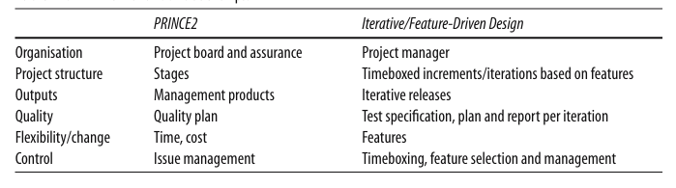
If you consider the emphasis of the Feature-Driven approach, then similarities with some aspects of PRINCE2 can immediately be seen.
For example, product /feature-based planning, the involved partnership of users and developers and the strong emphasis on the underlying business need - case.

Slide 13
Tools to help with agile development
So what tools should you use in support of an agile project?
To answer this question, let us first consider what tool requirements Agile Software Development imposes on us. Some of these requirements are presented below
We should be able to refactor software simply and easily.
It should be possible to modify existing software securely in the knowledge that we can role back to an earlier version if it all goes horribly wrong.
We should be able to track changes in the system.
We should be able to run and re-run test suites simply and to review the results easily and immediately.
If we are undertaking to perform Agile Modelling, then we should be able to reverse engineer code into models simply and with a minimum of fuss. We should be able to modify code or models and keep both in sync. We should be able to update models without the need to heavy weight tools
Ideally, we also want something that will tell us when we need to create a new build.

Slide 14
The tools listed below are those that have found to be particularly useful. They represent the most common areas that can benefit from tool support within an agile Java development project
An IDE that can be integrated with the other tools proposed, which supports refactoring and iterative development.
A lightweight modelling tool to help with Agile Modelling.
A build tool to allow simple and rapid rebuilds of the system as and when necessary.
A version control system to handle the frequent and rapid changes introduced into the software and to allow the software to roll back when necessary.
A test framework to handle the unit tests so important to agile software development

Slide 15
Eclipse: An agile IDE
Eclipse is an extremely powerful open-source IDE that can be used for developing projects in a variety of languages
Eclipse was originally developed by IBM but was moved to an open-source model
Not only is it an open-source system but it is also an open platform that allows additional tools to be plugged into it to extend its basic functionality
Eclipse is also fast, lightweight and relatively small. It is written in Java and is thus cross platform - allowing developers on a variety of platforms to all use the same IDE.

Slide 16
As an IDE, Eclipse offers the standard suite of features we expect, including:
Syntax analysis of code as it is entered
Integrated context-sensitive help system
Auto-complete
Pop-up function/procedure prototypes
View source of supplied components
Ability to run applications from within the tool
Integrated debugger
Variety of wizards for creating different types of Java element
Integration with version control systems
Sophisticated, context-sensitive, search
Various perspectives (including code, class, inheritance, etc.)
Integration with Java development tools such as ANT, Junit, etc

Slide 17
Obstacles to Agile Software Development
Management intransigence
The failed project syndrome
Contractual difficulties
Familiarity with agility

Slide 18
Management intransigence
The drive towards agile software development often comes from the developers themselves or from developer teams.
In such situations, management can represent a significant obstacle to adoption of an agile approach.
This can be for a host of reasons that include:
Lack of familiarity with Agile Software Development methods.
Mis-comprehension of what eXtreme Programming and Agile Modelling offers
A feeling of losing control - as agile methods are more dynamic in terms of planning activities than traditional approaches.
Remoteness from the actual coalface and thus remoteness from development issues.

Slide 19
The need to feel that they have the whole project planned out in advance.
Lack of suitability for their own review-and-assessment process. That is, if they are assessed on a more traditional waterfall model, then they may have the production of a detailed project plan as one of their aims and objectives to be completed.
Belief that adopting eXtreme Programming (and thus doubling developers up) will actually halve productivity. Although current research indicates that the opposite is actually true.
The parapet syndrome. That is, a manager may not want to risk a different approach to that normally adopted
The fear of the unknown!

Slide 20
The failed project syndrome
Having a successful agile project in another part of your organization can really help you to convince management of the benefits of the new approach.
However, the failed agile project can of course have the reverse effect – i.e. merely proving their belief in the futility of this agile thing!
In a bid to retain credibility with the client in general, If we drill down and find out what the issues had been with the project. It turned out that
No one involved in the project had ever done an agile development before.
Half the developers had limited commercial software development experience anyway.
The belief appeared to be that you should never comment code (it was self documenting).
They never wrote any documentation (believing it not to be the agile way).
They never did any design (as they considered design to be the antithesis of agility).
Refactoring appeared to have been an area they considered a waste of time!

Slide 21
Contractual difficulties
contracts traditionally have been based around a waterfall software development approach
In general, we have found that working with clients so that they understand some of the benefits from their side is essential to the adoption of an agile development method.
In particular, we have found emphasizing the following to be useful
The level of control/influence they can exert.
The feedback they will receive
The ability to prioritize features

Slide 22
Familiarity with agility
One major obstacle to adopting an agile software development is the lack of knowledge of how to start and run such a project
However, until you have been involved in one or more agile software developments, a great many questions may stop you in your tracks.
For example some of the questions are,
"how do we estimate the cost of the software to the clients at the start of a project?”
“how do we decide how many iterations will be there?”
“how do we know what will be in each iteration?” and
“how do we decide how long an iteration should be?”

Slide 23
How do you estimate the cost of the software to the clients?
The issue here may appear to be a question of how can we determine how much this software will cost for us to develop, given that we don’t yet know exactly what we will do
How do we decide how many iterations there will be?
This may appear as an obstacle because the question being implied here is “how many iterations will it take to implement all the requirements?”
How do we know what will be in each iteration? Again this question arises from the more traditional waterfall mindset–it is really saying,
“I want to know exactly what will be done in all iterations of the project.” Whereas, agile methods essentially say that we will roughly decide will be planned for each iteration

Slide 24
How do we decide how long an iteration should be?
Each iteration should be large enough to contribute something of value to the end-user, but small enough to allow for rapid and useful feedback from those users

Slide 25
Building Applications with ANT
ANT is the Java build tool;
What ANT can do and highlight its integration with the Eclipse tool. Using ANT, it is possible to:
Extract all the current source from a version control system such as CVS.
Compile all the Java code in a system.
Automatically generate a build number, provide a build date stamp, add a version number to a property file, etc.
Jar that code up into a single file.
Copy that jar to a deployment location.
Generate the Javadoc for the compile system.
Copy the Javadoc to an appropriate location.
Create Web Archives (WARs).
Create Enterprise Archives (EARs).
Deploy WARs and WARs to servers (such as Tomcat or JBoss).
Start up servers such as Tomcat and JBoss.

Slide 26
ANT is written in Java and uses XML configuration files to control its build process.
These build files, called “build.xml” by default, control what ANT does and how it does it
Each build file contains one project that describes an ANT activity such as the compilation of some Java code
ANT build-all
Eclipses’ ANT support allows ANT processes to be executed from within the Eclipse tool.
This allows you to create and run ANT build files from the Eclipse Workbench.
These ANT build files can operate on resources in the file system as well as resources in the workspace.

